Slide 1
Ride duration
By alon grOd

Slide 2
Topic Details:
Data analysis.
Make a machine learning model that will use simple linear regression algorithm to predict ride durations.
We will train our model on some previous data records of taxi ride predictions and then test it over new identical data

Slide 3
Dataset
Columns:
1. id - a unique identifier for each trip
2. vendor_id - a code indicating the provider associated with the trip record
3. pickup_datetime - date and time when the meter was engaged
4. passenger_count - the number of passengers in the vehicle (driver entered value)

Slide 4
5. pickup_longitude - the longitude where the meter was engaged
6. pickup_latitude - the latitude where the meter was engaged
7. dropoff_longitude - the longitude where the meter was disengaged
8. dropoff_latitude - the latitude where the meter was disengaged
9. trip_duration - duration of the trip in seconds (Labels / To Predict)

Slide 5

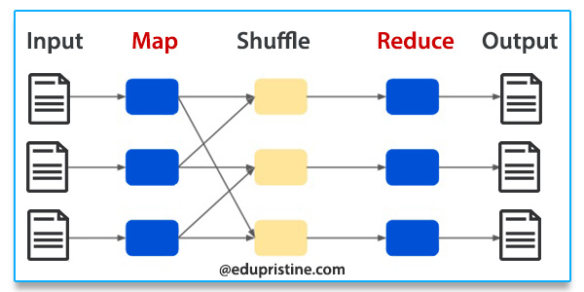
Technologies used:
Dynamo database
Hadoop( MapReduce)

Slide 6


Platforms used:
Java Eclipse
Amazon Web services

Slide 7
Motivation to use these technologies:
MapReduce is a framework which helps in writing applications that processes large data sets using parallel algorithms in distributed Hadoop environment.
DynamoDB is a fast, fully managed NoSQL database service that makes it simple and cost-effective to store and retrieve any amount of data, and serve any level of request traffic.

Slide 8
Linear regression Implementation:
What is linear regression:
Most basic machine learning algorithm
Linear regression is a basic and commonly used type of predictive analysis. In this type of regression we use a line to model our data.
Simply stated, the goal of linear regression is to fit a line to a set of points.

Slide 9
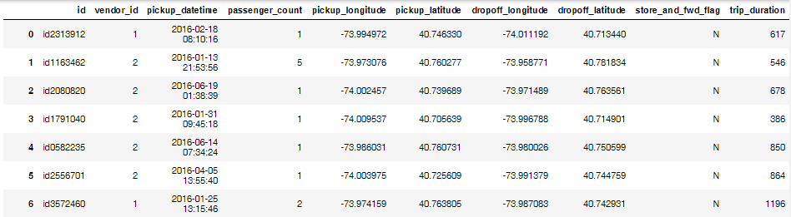
Dataset sample:

Slide 10
Training model:
Model is trained on the following columns:
vendor_id,
passenger_count,
pickup_longitude,
pickup_latitude,
dropoff_longitude,
dropoff_latitude,
trip_duration

Slide 11
Building of model:
Data cleaning.
Missing NAN/NULL values
Dropping rows with more than 3 nan columns
Standardization of data
Finding the best values for weights using mapReduce

Slide 12
Why mapreduce:
Hadoop MapReduce allows parallel processing of huge amounts of data
It breaks a large chunk into smaller ones to be processed separately on different data nodes
It automatically gathers the results across the multiple nodes to return a single result.

Slide 13
Testing model:
After getting appropriate values for weightages, we will multiply the weightages with test data columns.
Same columns will be used for predictions.
Checking accuracy of the model

Slide 14
Results(Showing only first 10 test examples):
Predicted value | Actual Value
1054.879 | 1001.985
762.2789 | 762.2153
923.5858 | 855.1127
854.2435 | 850.1119
694.3533 | 852.3233
1063.839 | 896.2147
747.7618 | 951.7392
696.2637 | 686.0201
392.9058 | 479.1420

Slide 15
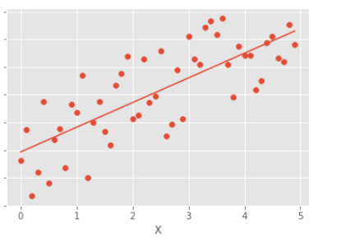
Graphical analysis:

Slide 16
Conclusion:
Prediction Accuracy: 65%
Map Reduce saves time cost by parallel processing of data.
Linear Regression is most simple model for predictions

